Slide 1
Trauma Informed Care
October 30, 2018

Slide 2
Trauma Informed Care (TIC) recognizes that traumatic experiences terrify, overwhelm, and violate the individual.
Trauma Informed Care is a commitment not to repeat these experiences and, in whatever way possible, to restore a sense of safety, power, and self-worth.

Slide 3
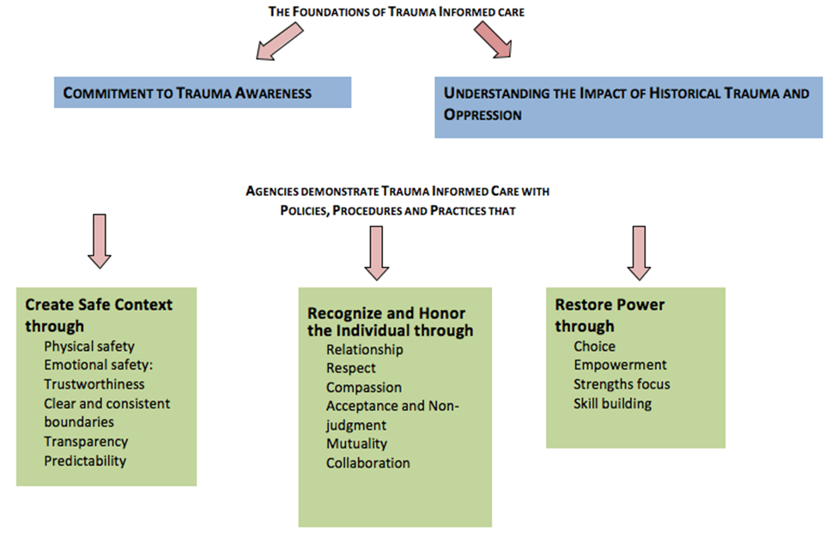

Slide 4
ROADMAP TO TAUMA INFORMED CARE
Programs, organizations, and systems that make a commitment to implementation will differ in many ways – from the service context, to the motivation for change, to hoped-for outcomes, and resources available.
Nonetheless, the implementation process has common features that we’ve tried to reflect in the Roadmap below.
On the left side of the map in the Foundational Readiness Phase are WHAT YOU NEED TO HAVE to begin the process of implementing trauma informed care.
On the right side of the map in the Implementation Phase are WHAT YOU NEED TO DO to start planning and making changes.

Slide 5
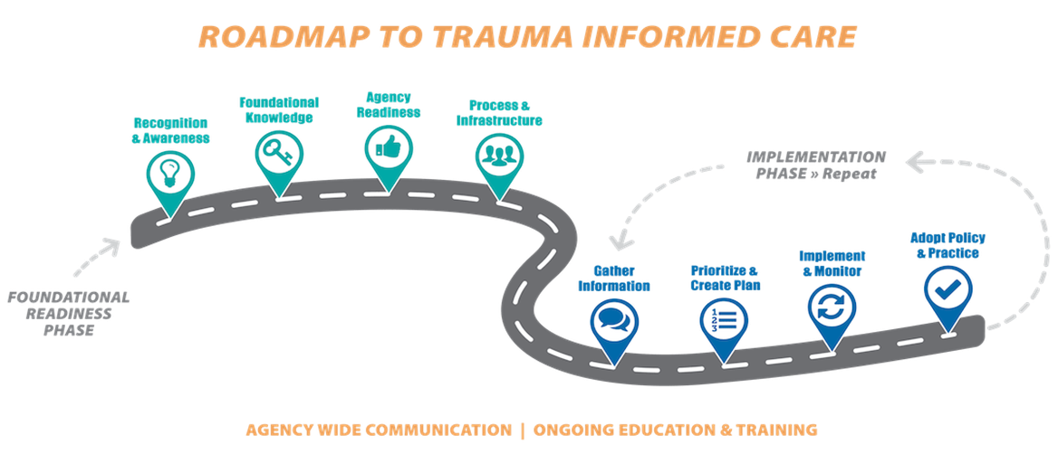

Slide 6
Loops in the road reflect the ongoing nature of the work, which is best supported by continuing education and training for all staff and by agency-wide communication to model the transparency, collaboration, and authenticity that are hallmarks of trauma informed care.

Slide 7
Purpose
Trauma is prevalent among social service recipients and those providing services. This can affect individuals’ ability and willingness to engage with programs either as a service recipient or as part of the workforce.
Further, the service setting has often been a source for re-traumatization. This awareness or trauma sensitivity is an important first step in becoming trauma informed.
Following are considerations about increasing awareness about this issue.

Slide 8
Considerations
• Understanding that services can be re-traumatizing for both the service recipient and the workforce is central to trauma informed care.
o Organizations learn to recognize when and how services are activating.
• Understanding the prevalence of trauma within the population served by your agency builds awareness and is an important component of trauma informed care.
o Research and literature is widely available describing the prevalence and impact of trauma across most service sectors. This information increases trauma sensitivity, in general and can be found in a number of sources including the popular media.
• Understanding the prevalence of trauma and work related stress within the workforce is also an important component of trauma informed care.
o A number of instruments are available to measure work related stress, including: burnout, vicarious trauma, and secondary traumatic stress.

Slide 9
Purpose
As part of building awareness, all staff benefit from having fundamental knowledge in trauma informed care. Training involving all staff helps form a common language within an organization and demonstrates a commitment to creating a sensitive, safe, and welcoming environment for service recipients and the workforce.

Slide 10
Considerations
• A broad base of trauma-related knowledge should include the following content:
o The Adverse Childhood Experiences (ACE) study
o The prevalence and impact of trauma on individuals by your agency
o An introduction to the neurobiology of trauma
o Issues of power, oppression, and micro aggression especially related to
involvement with our organizations and service systems
o Historical, collective, and intergenerational trauma
o Principles and implementation of Trauma Informed Care (TIC)
o The role and benefits of peer support services
o Trauma in the workforce; secondary trauma
• Knowledge can be gained through
o Training (internal or external)
o Webinars and Videos
o Books and discussion groups

Slide 11
• All levels of the organization should receive training and education. This includes reception, billing, management, support staff, volunteers, and direct providers.
• Organizations can build their own internal capacity to provide foundational education and training.
• Frequency and availability of foundational training and education should reflect the needs of the agency – with the following recommendations:
o New employees should receive education in core principles of Trauma Informed Care as part of the hiring and onboarding process.
o Foundational training is updated and offered annually to incorporate the rapidly accumulating information on this topic.

Slide 12
Purpose
Trauma Informed Care (TIC) requires a commitment from agency leaders and staff. Individuals within the organization must believe trauma informed care is needed, appropriate, and possible given the service setting and circumstances.
Readiness, both in terms of psychological (attitudes, values, and beliefs) and structural factors (skills, knowledge, and infrastructure) is important to consider if TIC is to be embraced and sustained.

Slide 13
• When the organization shows readiness:
o The agency reflects TIC principles in the mission, vision, and strategic plan (or plans to).
o The agency has resources available to support trauma informed efforts.
o The agency supports continuing education and training.
▪ The workforce has the skills, capacity, and knowledge necessary to practice trauma informed care.

Slide 14
• When the workforce (individuals) shows readiness:
o The staff believe TIC is needed in their agency.
o The staff believe they, individually, have the capability and capacity to practice TIC.
o The staff believe the agency will support a culture of TIC.
o The staff believe TIC will benefit everyone involved with the agency.

Slide 15
• Readiness can be created through:
o Education and training.
o TIC examples.
o TIC implementation efforts
(e.g. seeing TIC in action can promote the beliefs and structural factors outlined above).

Slide 16
